Slide 1

Week #9,#10
AI Academy®
1
Day 1, 2, 3:
Introduction Laravel & Architecture
Laravel Blade Template
MVC Architecture
Laravel Middleware
Reviews & Feedbacks

Slide 2


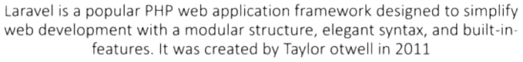
Week #9,#10
AI Academy®
2

Slide 3
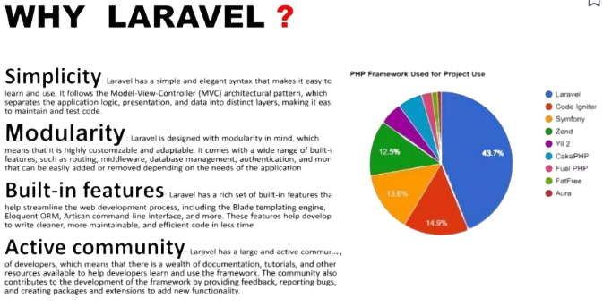
Week #9,#10
AI Academy®
3

Slide 4
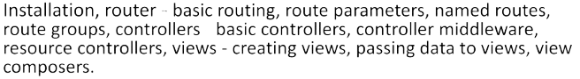


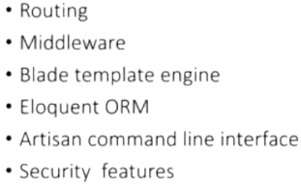
Week #9,#10
AI Academy®
4

Slide 5
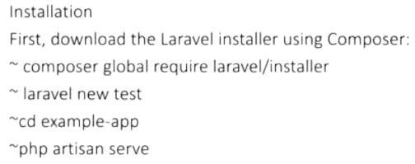
Week #9,#10
AI Academy®
5

Slide 6

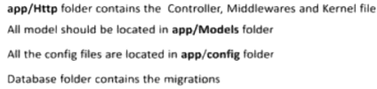
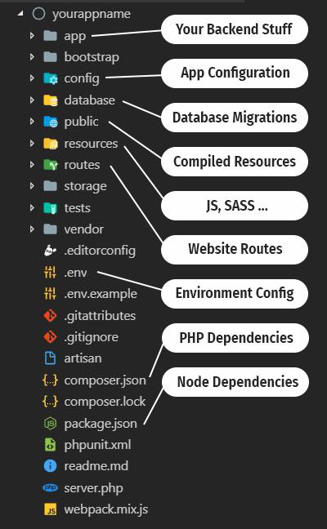
Week #9,#10
AI Academy®
6

Slide 7

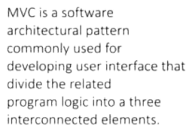
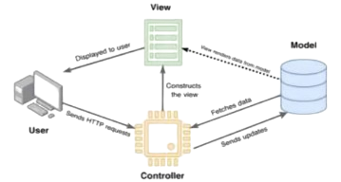
Week #9,#10
AI Academy®
7

Slide 8

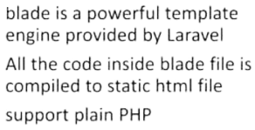
Week #9,#10
AI Academy®
8

Slide 9
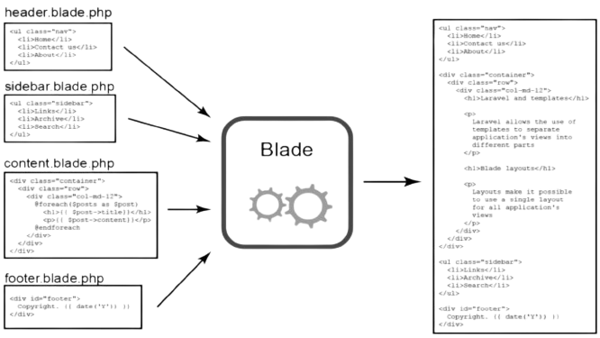
Week #9,#10
AI Academy®
9

Slide 10
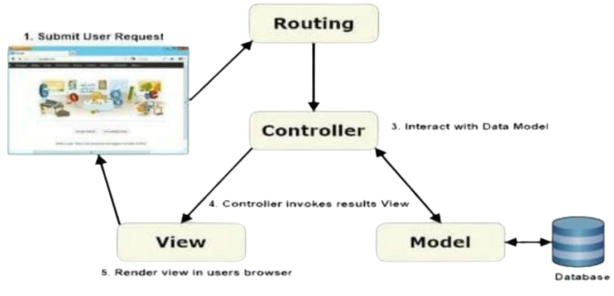
Week #9,#10
AI Academy®
10

Slide 11
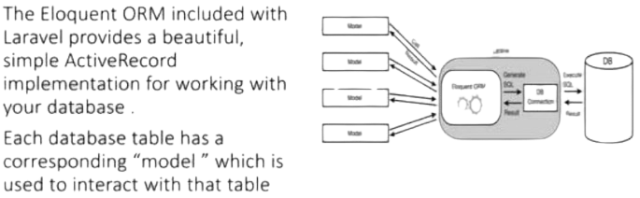
Week #9,#10
AI Academy®
11

Slide 12
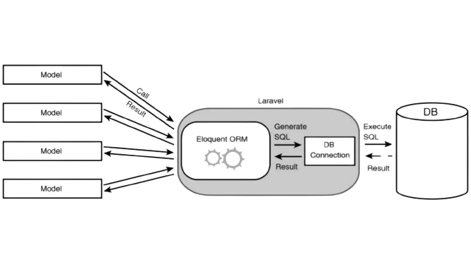
Week #9,#10
AI Academy®
12

Slide 13

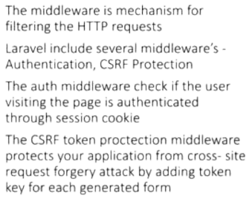
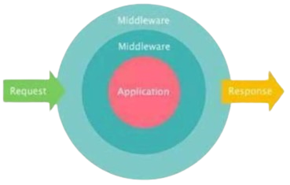
Week #9,#10
AI Academy®
13

Slide 14

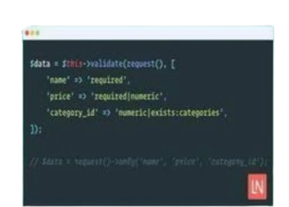
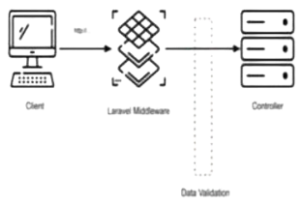
Week #9,#10
AI Academy®
14

Slide 15
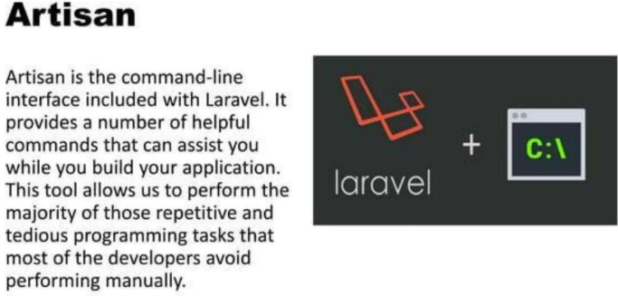
Week #9,#10
AI Academy®
15

Slide 16
Week #9,#10
AI Academy®
16
Day 4, 5:
Laravel Security
Laravel Controller
Laravel Model
Laravel Crud Application
Reviews & Feedbacks

Slide 17
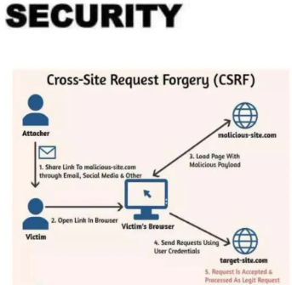
Week #9,#10
AI Academy®
17

Slide 18
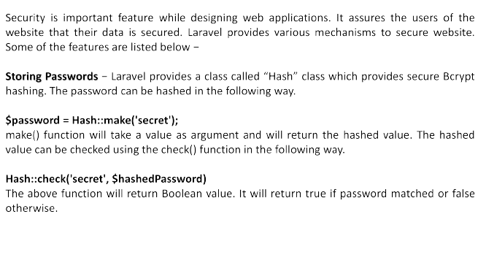
Week #9,#10
AI Academy®
18

Slide 19
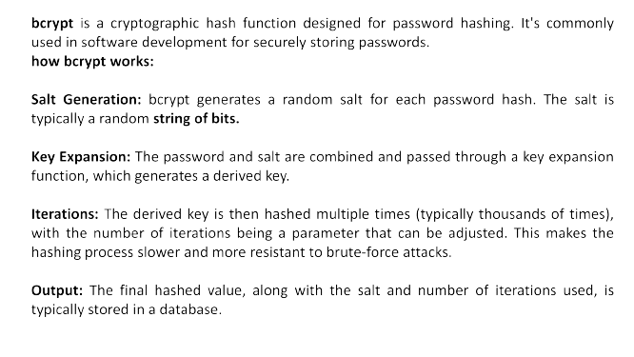
Week #9,#10
AI Academy®
19

Slide 20

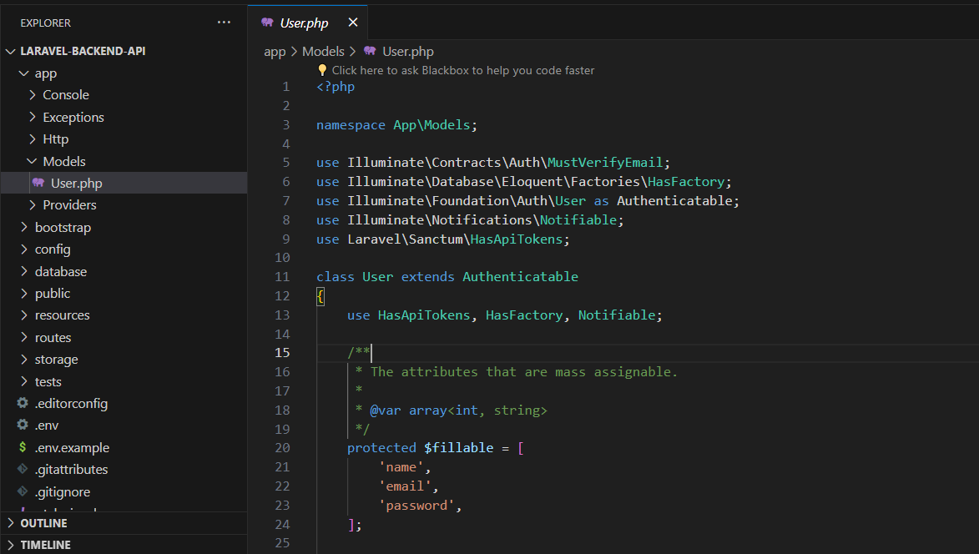
Week #9,#10
AI Academy®
20

Slide 21
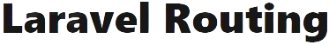
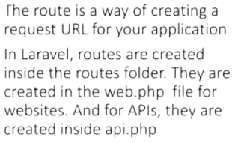
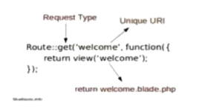
Week #9,#10
AI Academy®
21

Slide 22
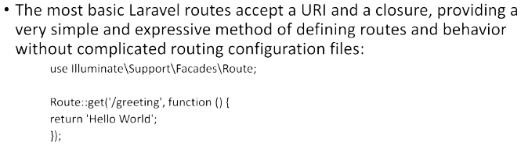
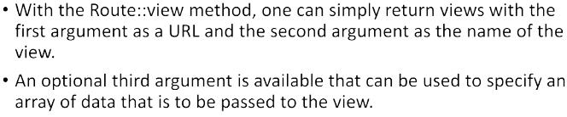
Week #9,#10
AI Academy®
22

Slide 23
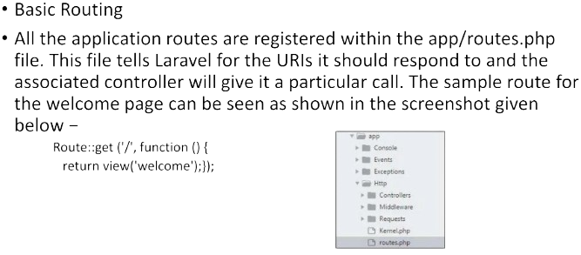
Week #9,#10
AI Academy®
23

Slide 24
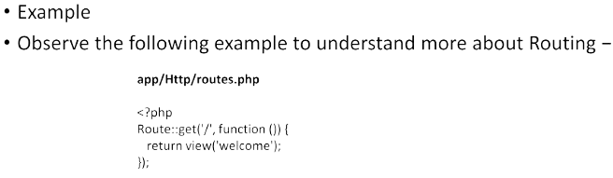
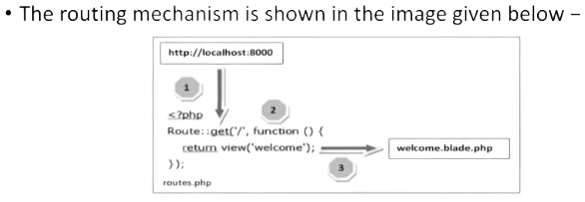
Week #9,#10
AI Academy®
24

Slide 25

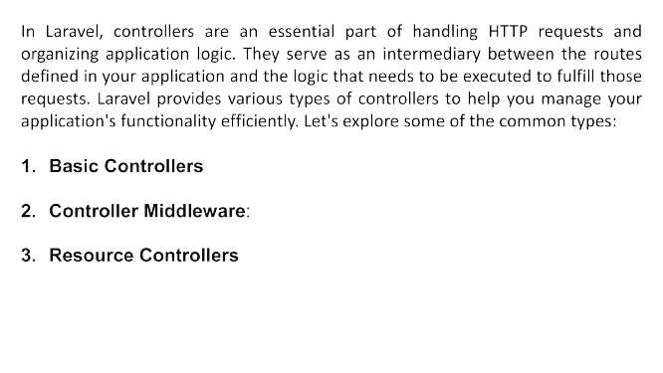
Week #9,#10
AI Academy®
25

Slide 26
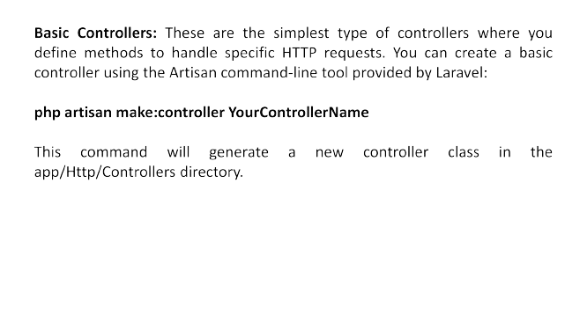
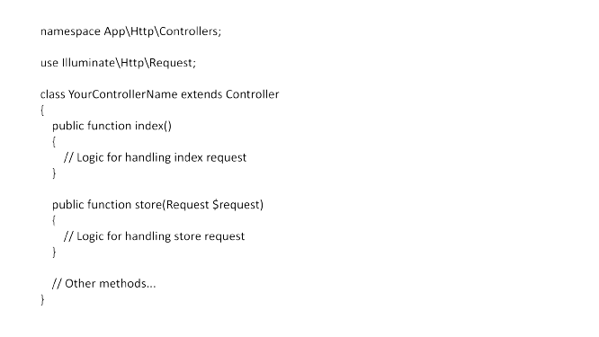
Week #9,#10
AI Academy®
26

Slide 27
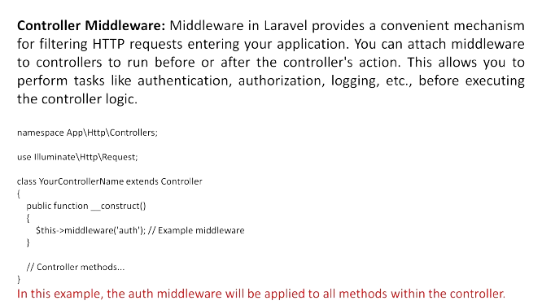
Week #9,#10
AI Academy®
27

Slide 28
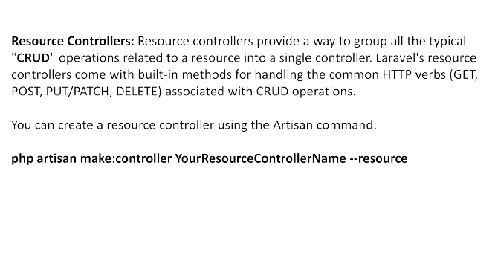
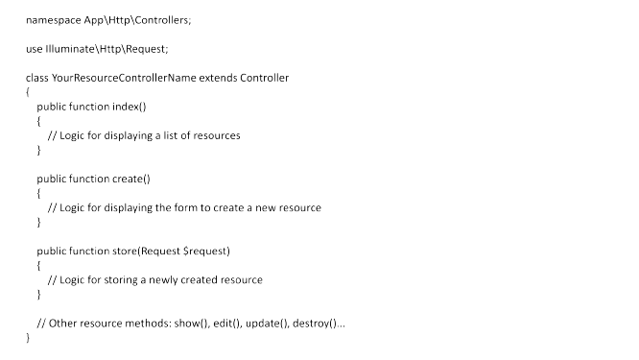
Week #9,#10
AI Academy®
28

Slide 29
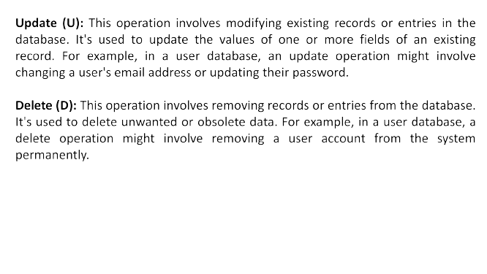
Week #9,#10
AI Academy®
29

Slide 30
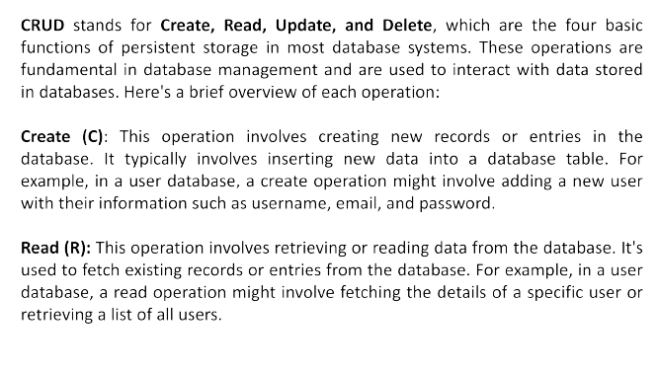
Week #9,#10
AI Academy®
30

Slide 31
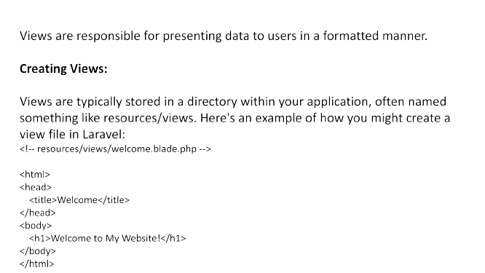
Week #9,#10
AI Academy®
31

Slide 32
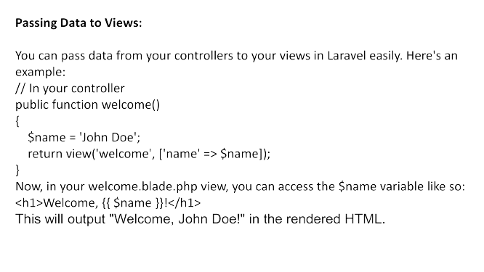
Week #9,#10
AI Academy®
32

